Slide 1
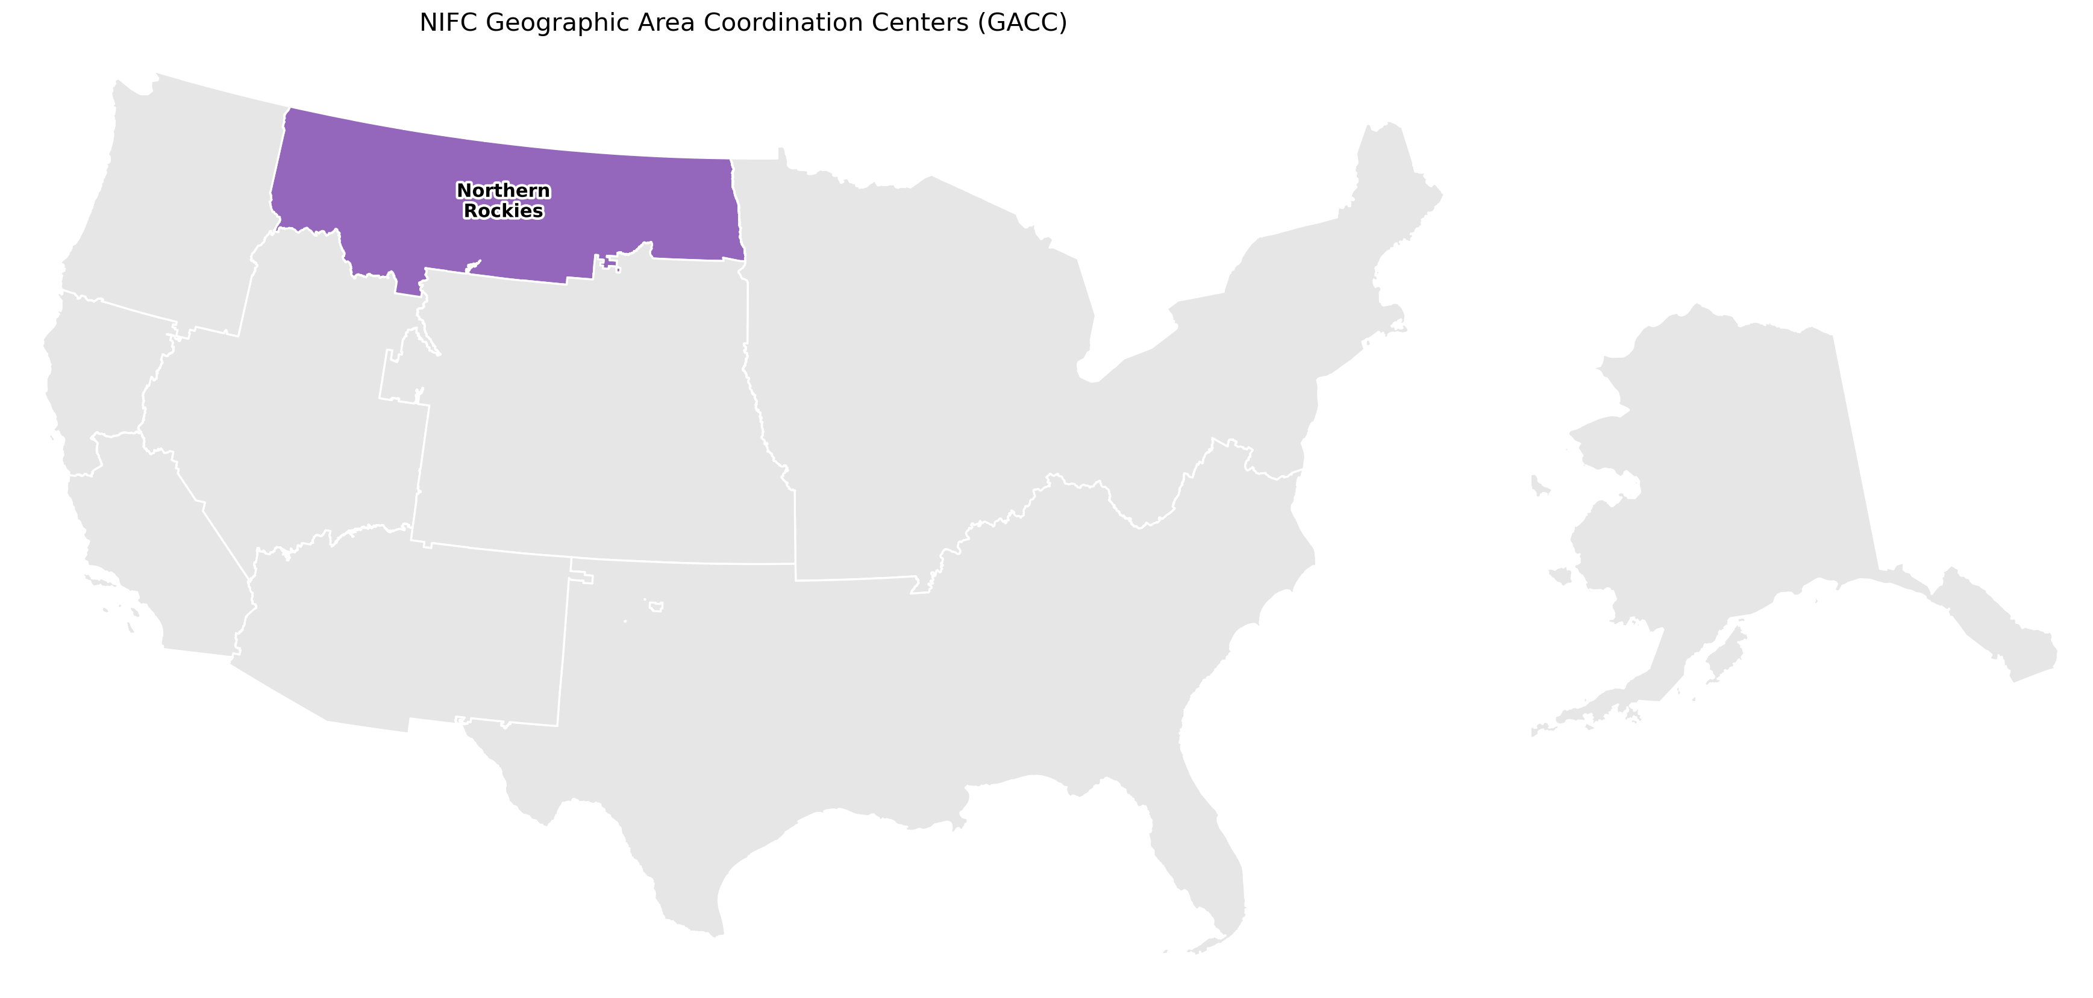
Northern Rockies
Human vs. natural ignition: fire size

Slide 2
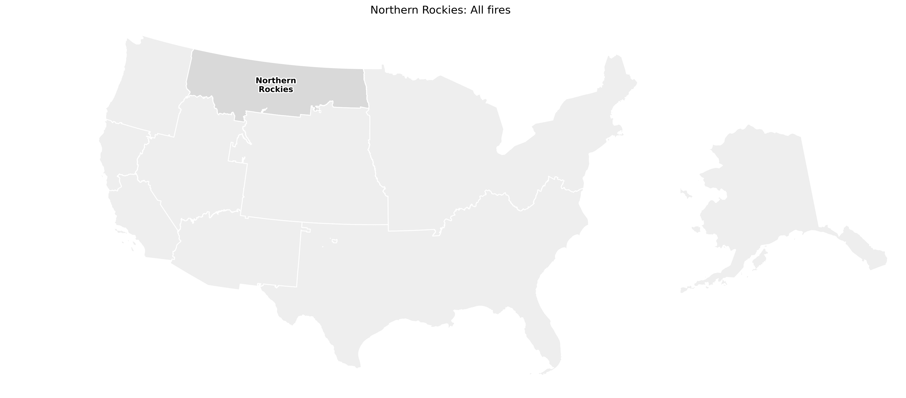
Northern Rockies: All fires
99,224 fires
Human: 58,883 fires
median 0.5 acres
Natural: 40,341 fires
median 0.2 acres
Rank-biserial r = +0.09
p = 2e-136
No meaningful difference

Slide 3
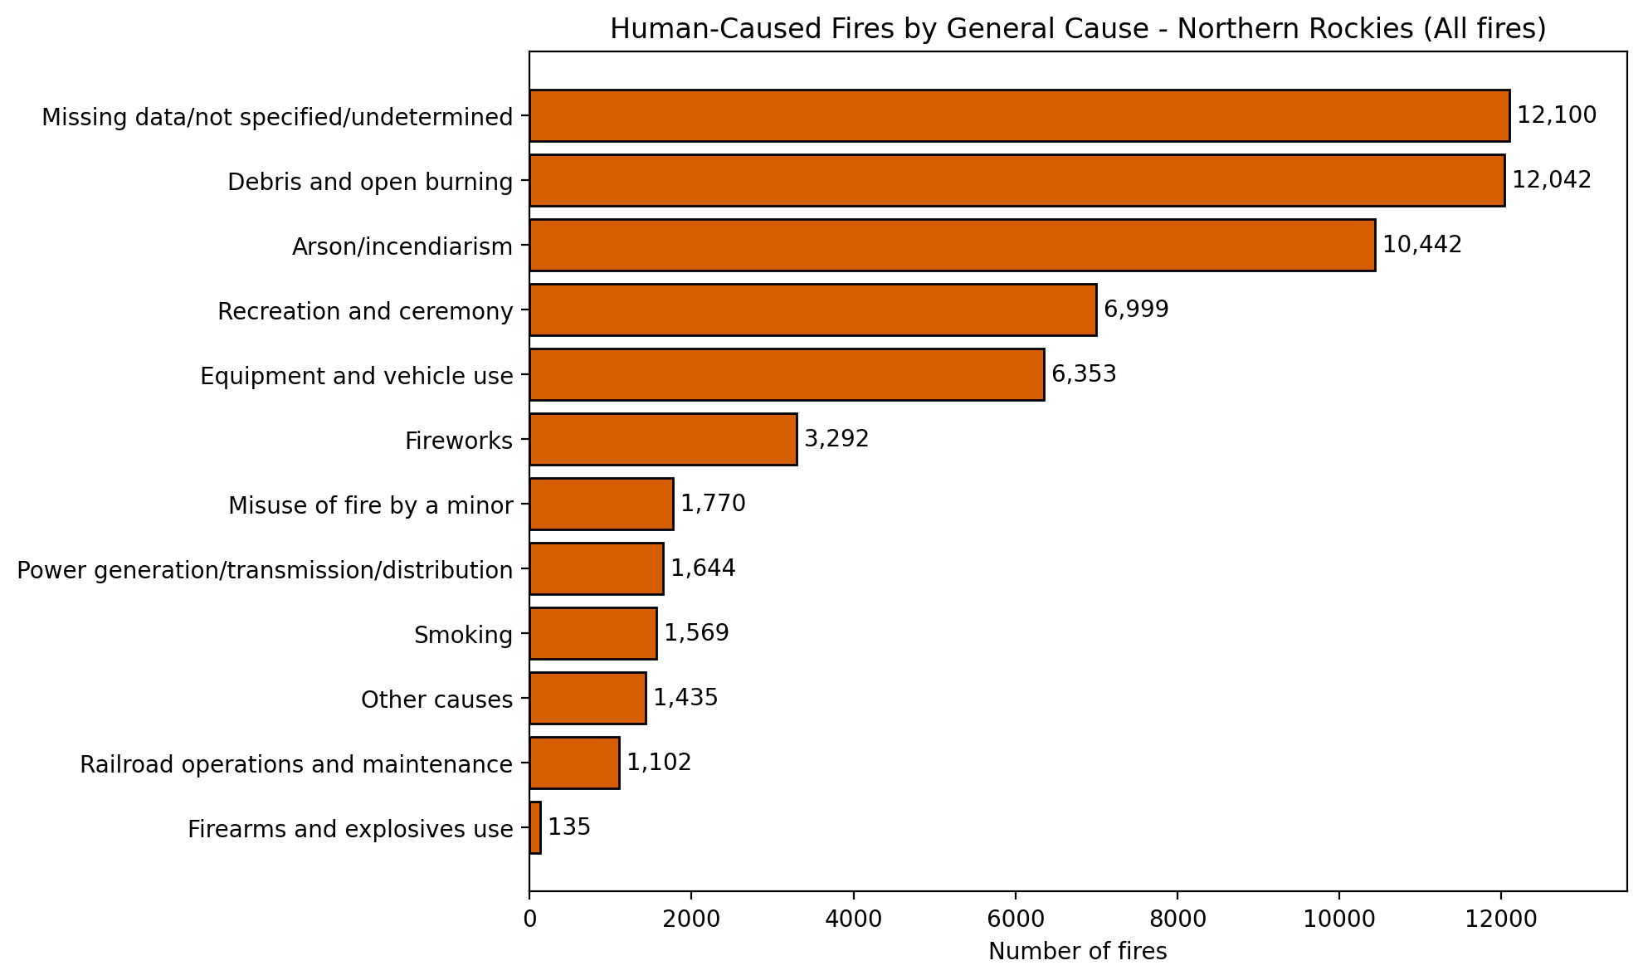
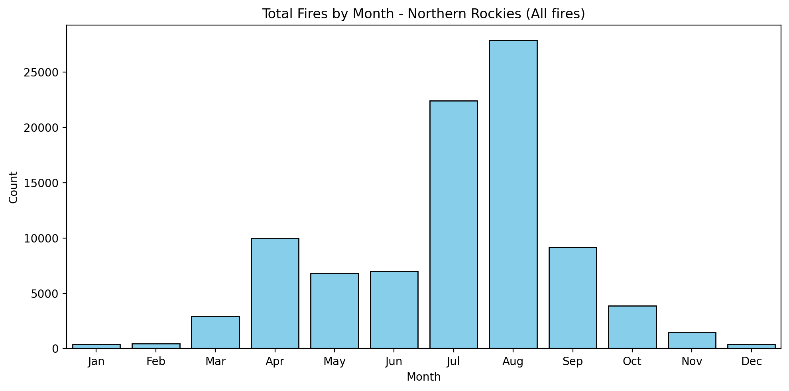
Northern Rockies: All fires

Slide 4
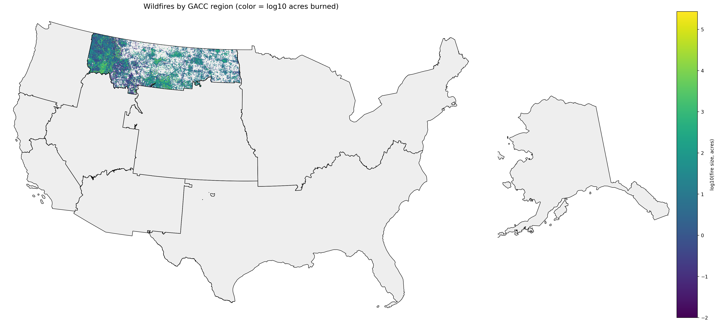
Northern Rockies: All fires

Slide 5
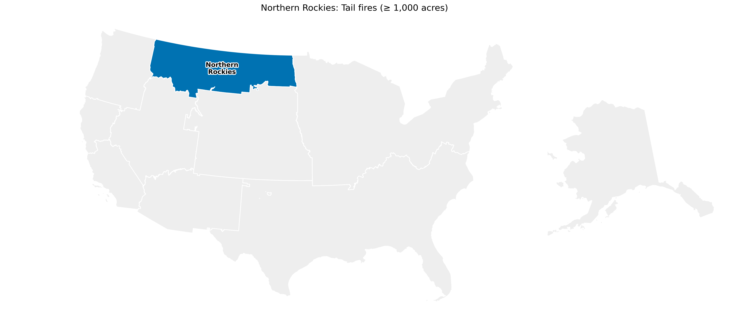
Northern Rockies: Tail fires (≥ 1,000 acres)
1,349 fires
Human: 365 fires
median 2,333.0 acres
Natural: 984 fires
median 3,407.4 acres
Rank-biserial r = -0.20
p = 1.6e-08
Natural Larger

Slide 6
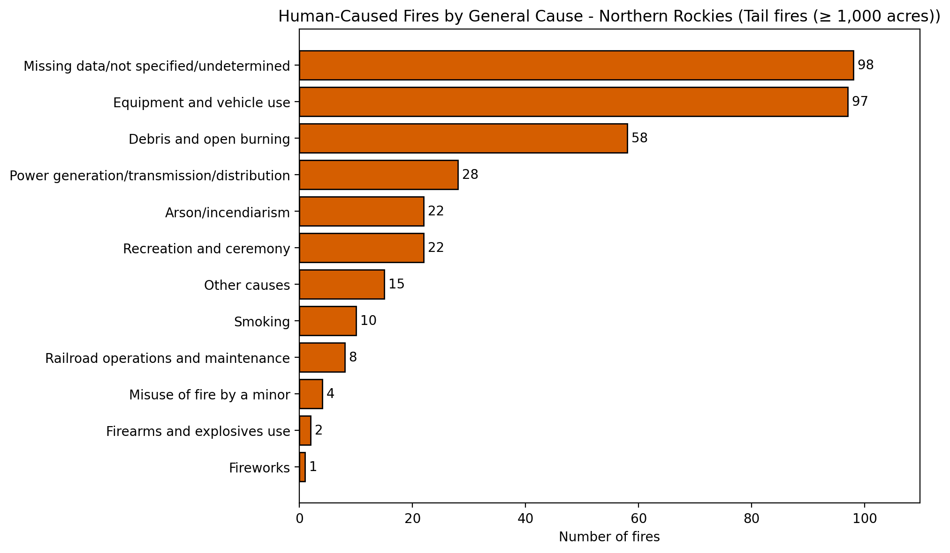
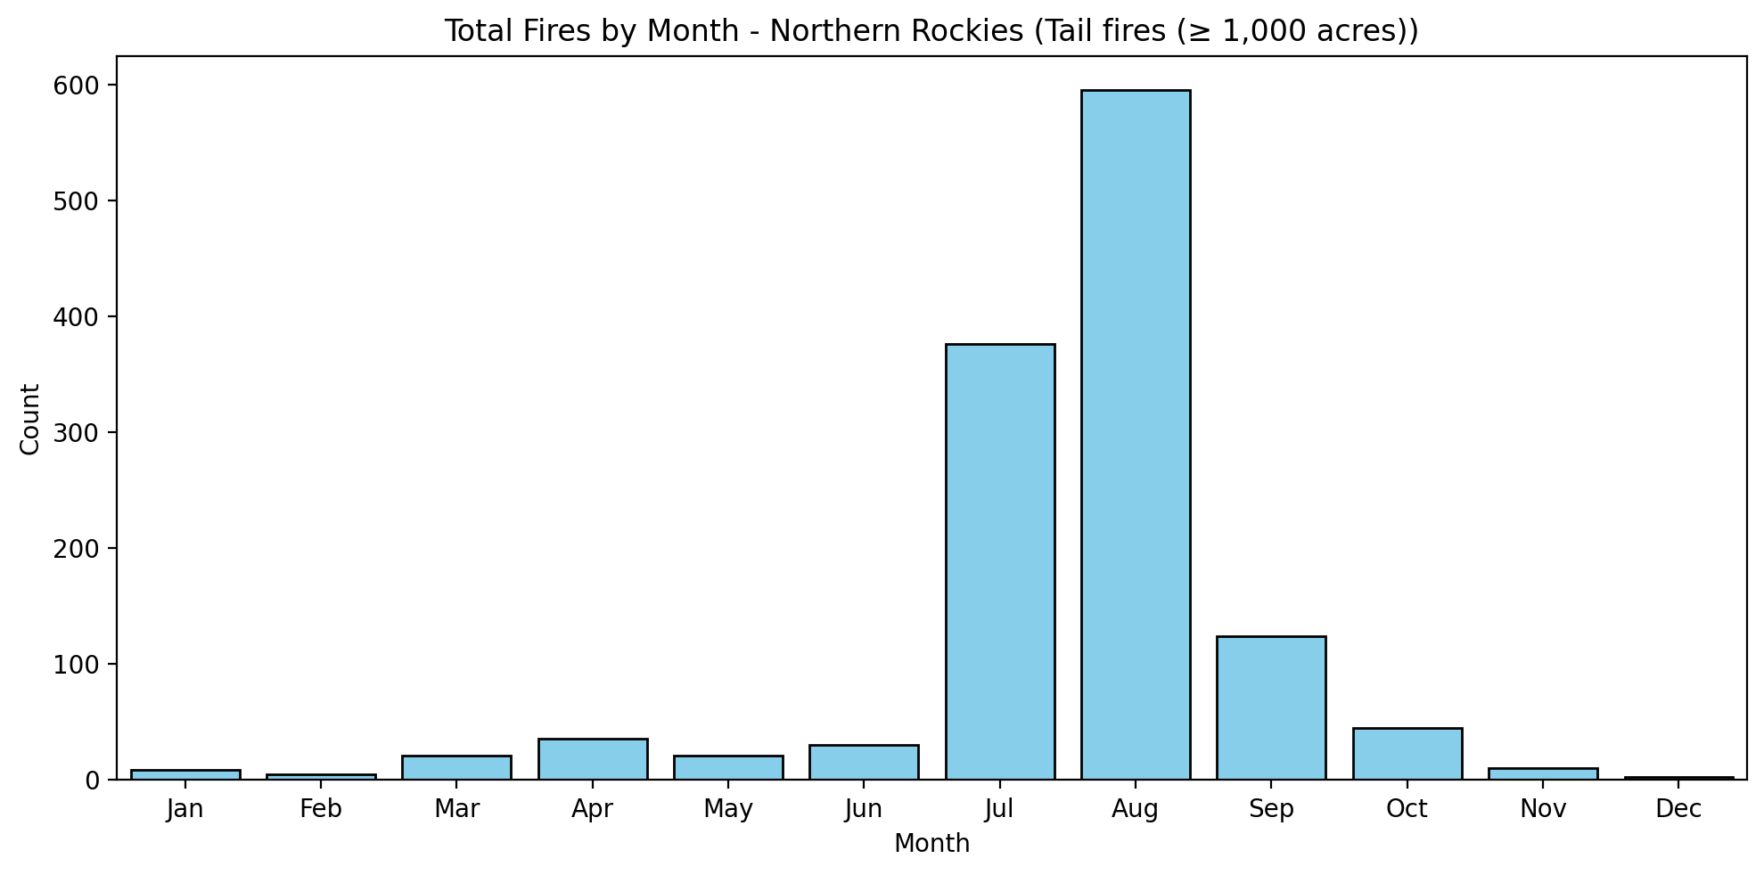
Northern Rockies: Tail fires (≥ 1,000 acres)

Slide 7
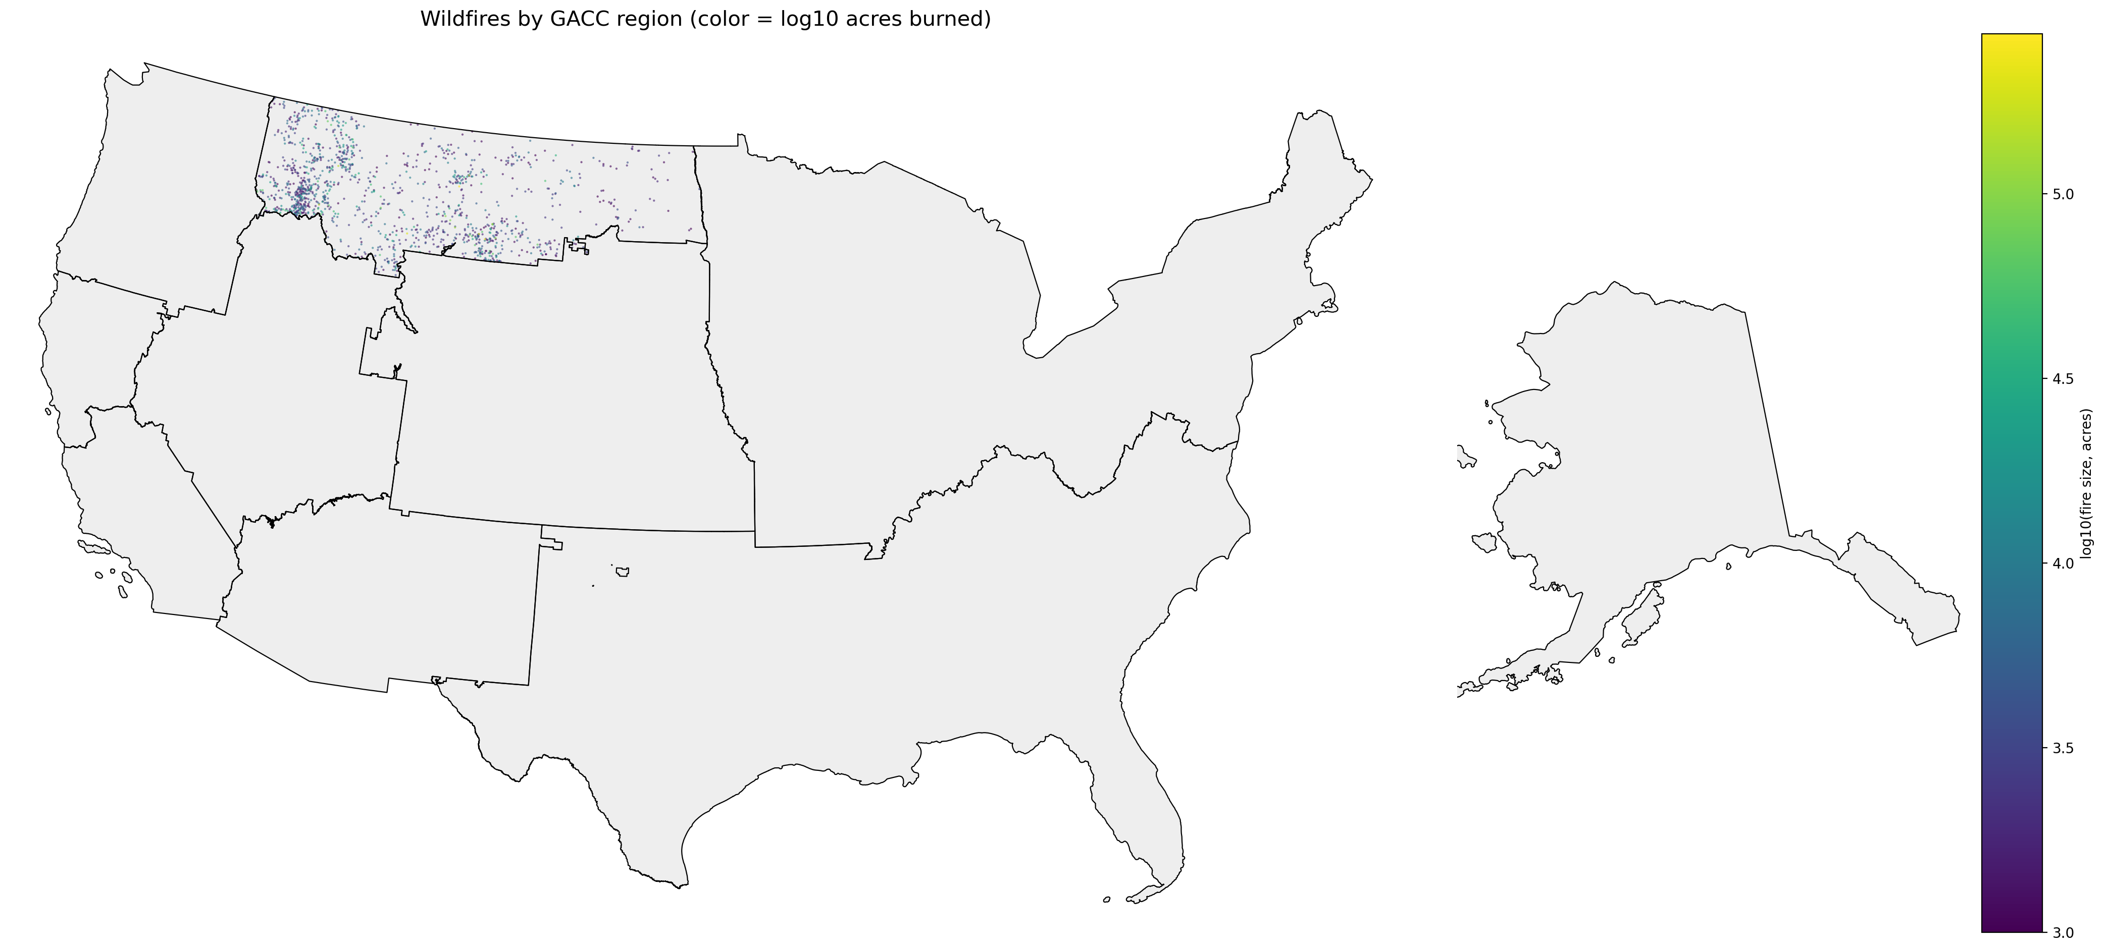
Northern Rockies: Tail fires (≥ 1,000 acres)

Slide 8
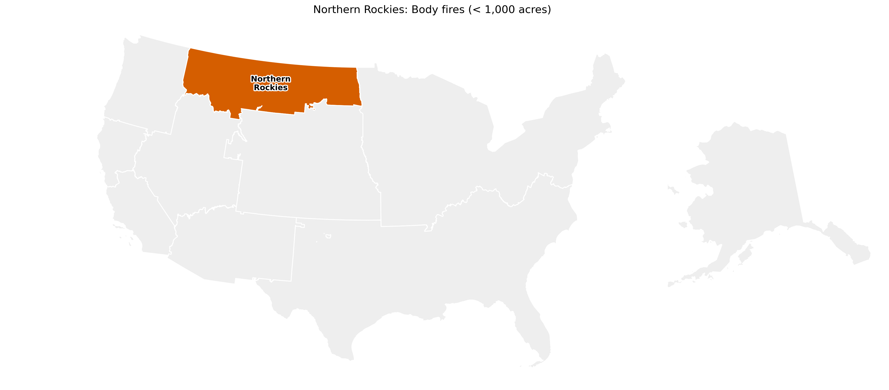
Northern Rockies: Body fires (< 1,000 acres)
97,875 fires
Human: 58,518 fires
median 0.5 acres
Natural: 39,357 fires
median 0.2 acres
Rank-biserial r = +0.11
p = 4.7e-206
Human Larger

Slide 9
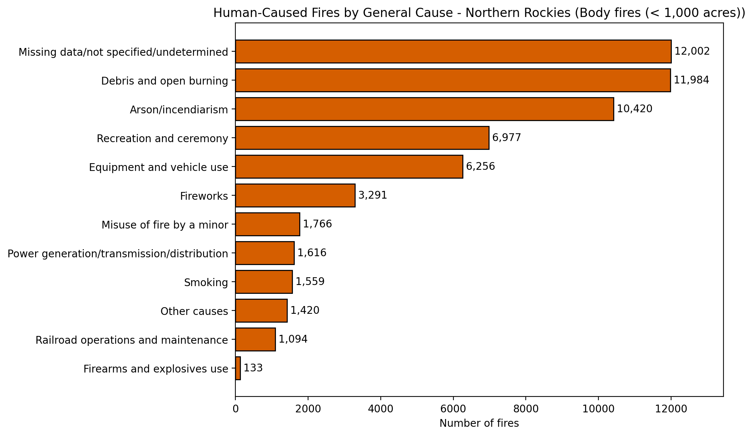
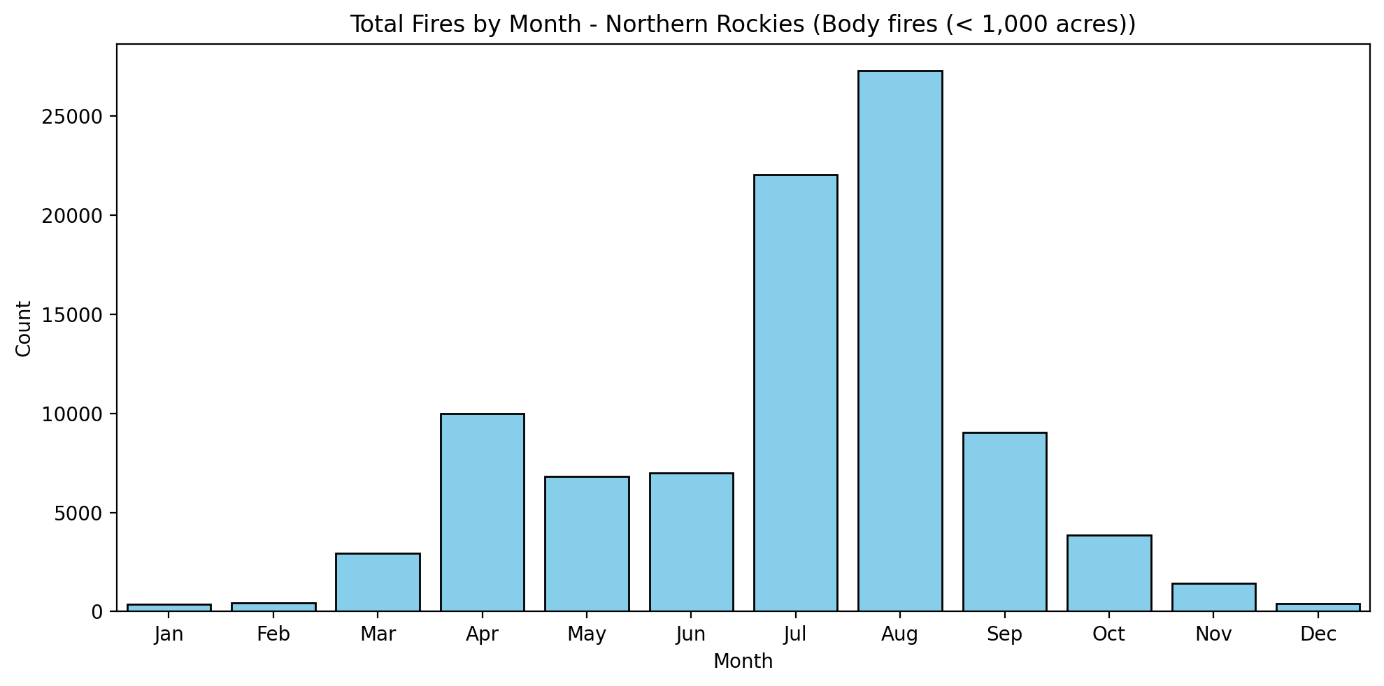
Northern Rockies: Body fires (< 1,000 acres)

Slide 10
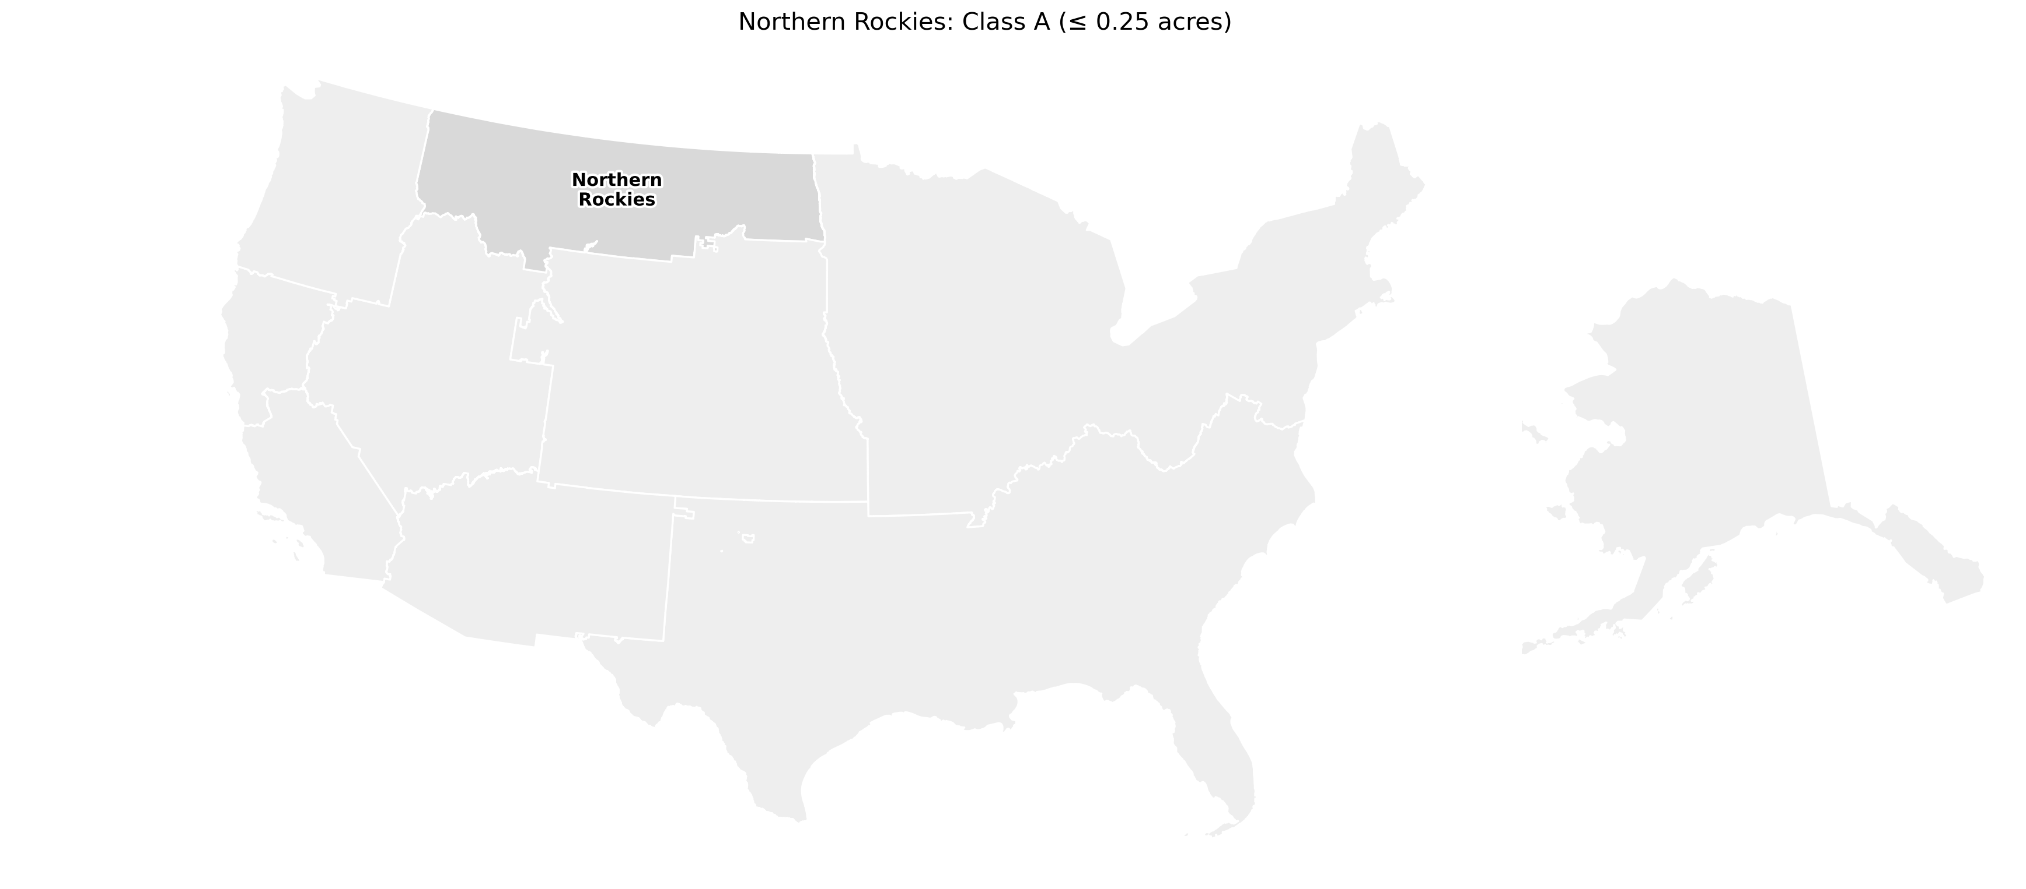
Northern Rockies: Class A (≤ 0.25 acres)
49,909 fires
Human: 26,594 fires
median 0.1 acres
Natural: 23,315 fires
median 0.1 acres
Rank-biserial r = -0.06
p = 5.8e-59
No meaningful difference

Slide 11
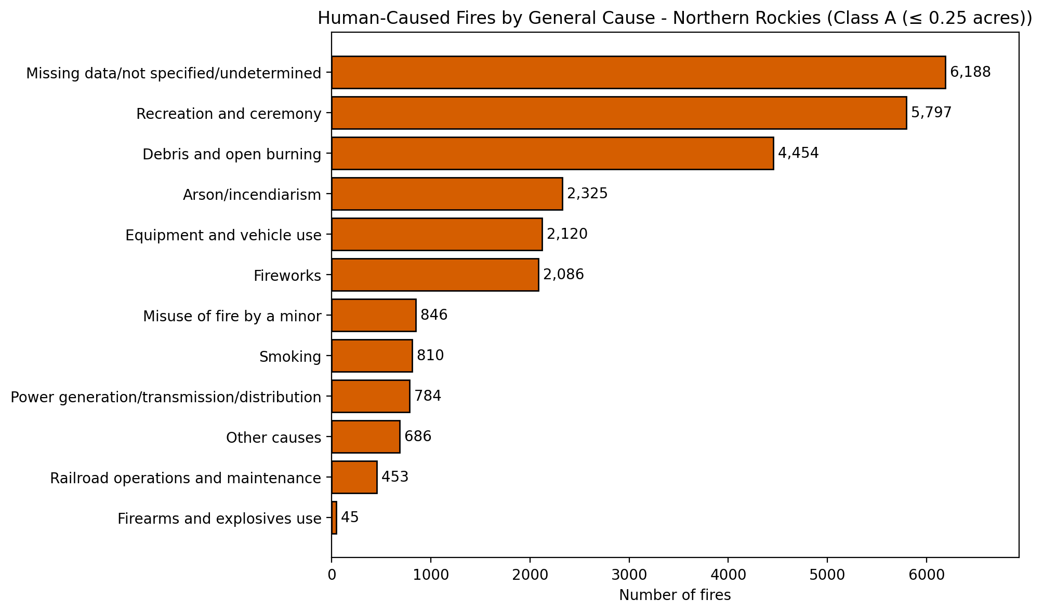
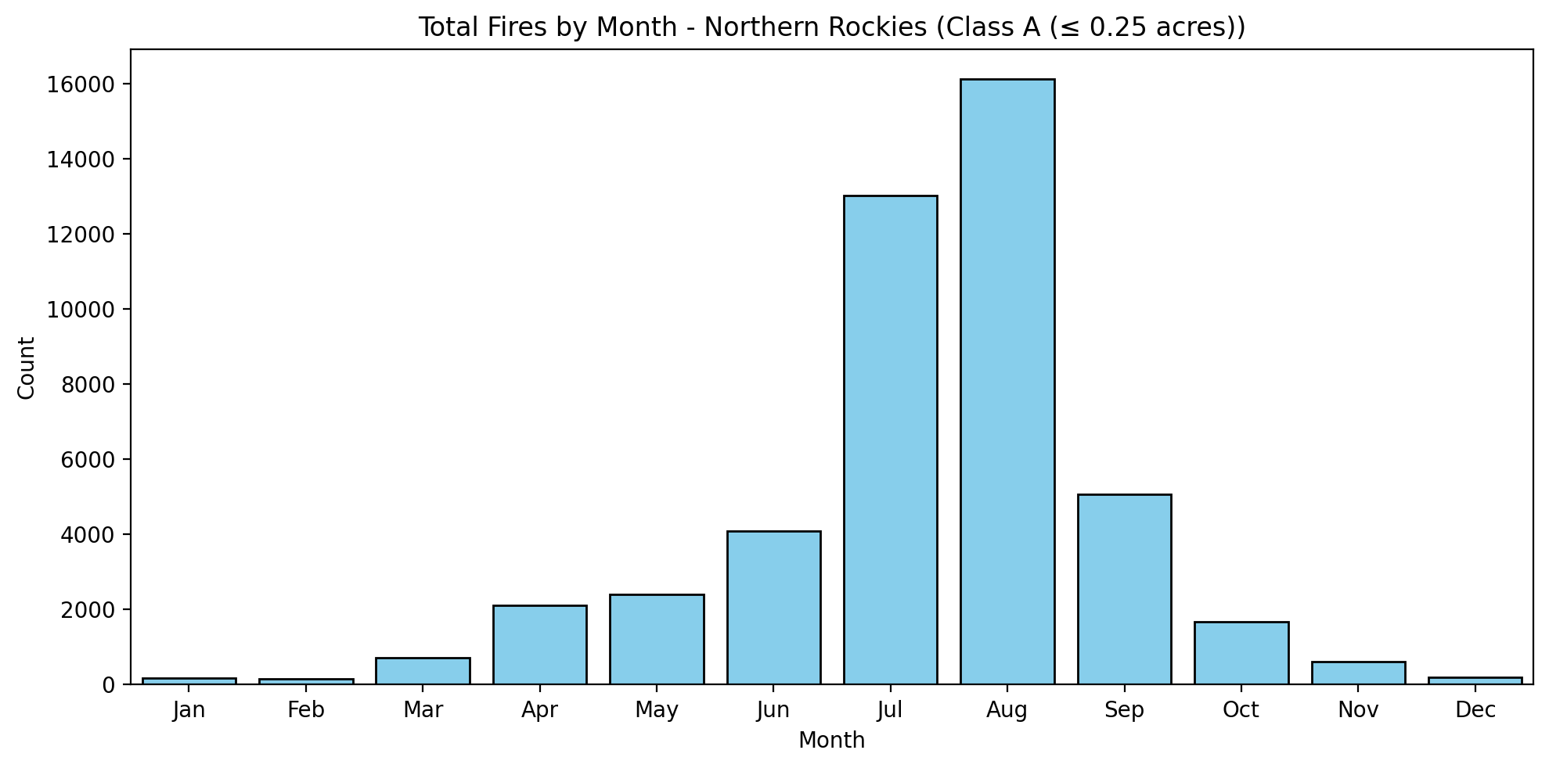
Northern Rockies: Class A (≤ 0.25 acres)

Slide 12
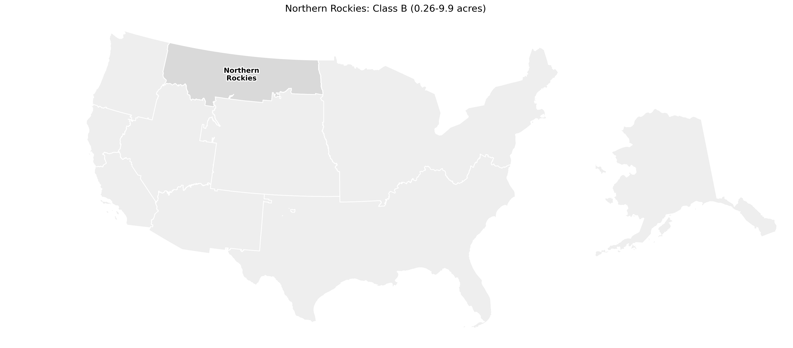
Northern Rockies: Class B (0.26-9.9 acres)
37,338 fires
Human: 25,713 fires
median 1.0 acres
Natural: 11,625 fires
median 1.0 acres
Rank-biserial r = +0.07
p = 1e-29
No meaningful difference

Slide 13
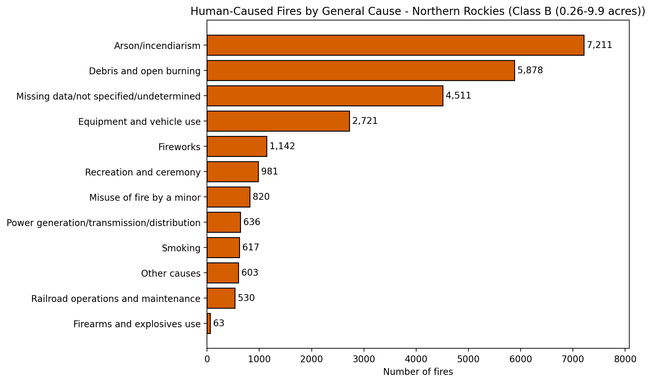
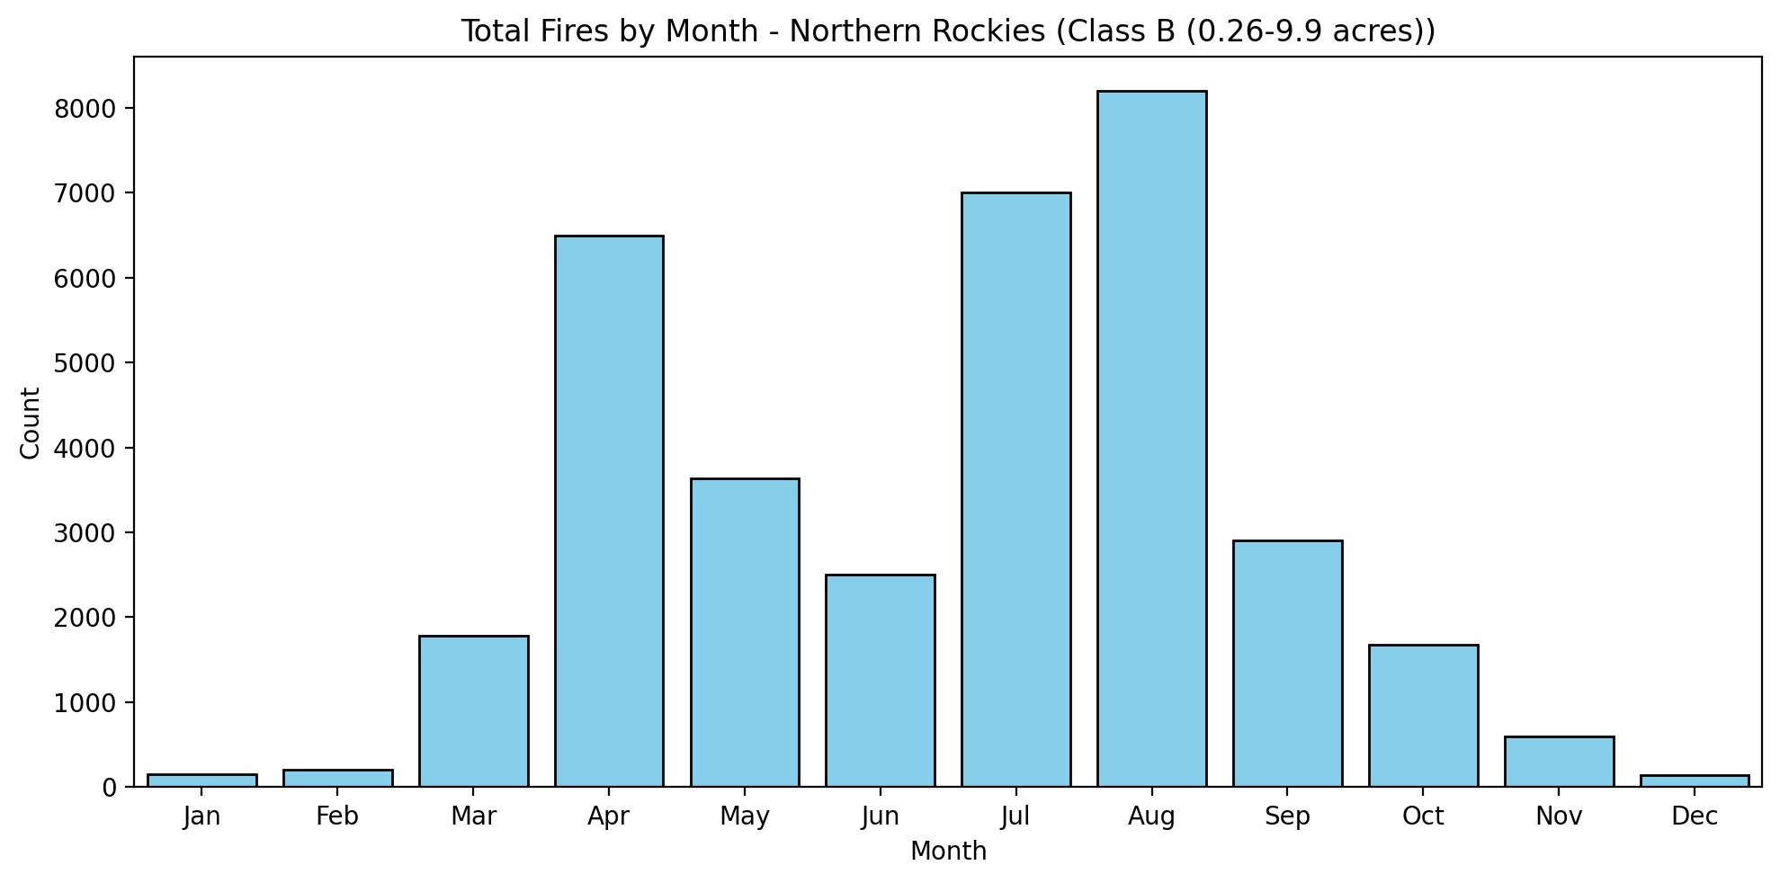
Northern Rockies: Class B (0.26-9.9 acres)

Slide 14

Northern Rockies: Class C (10-99.9 acres)
7,629 fires
Human: 4,785 fires
median 22.0 acres
Natural: 2,844 fires
median 25.0 acres
Rank-biserial r = -0.09
p = 5.7e-11
No meaningful difference

Slide 15
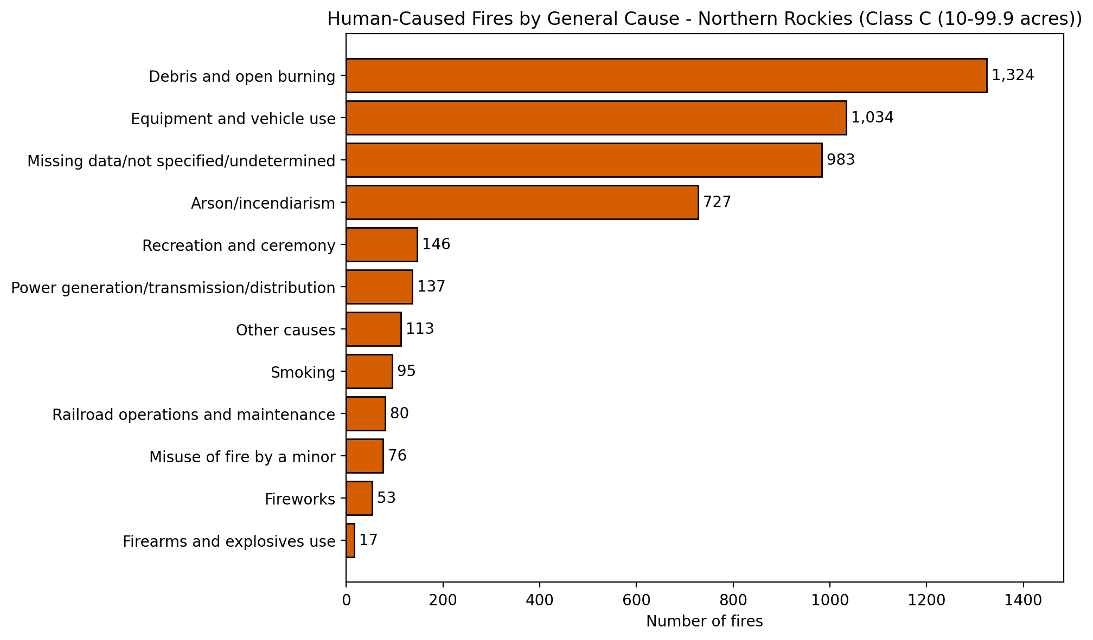
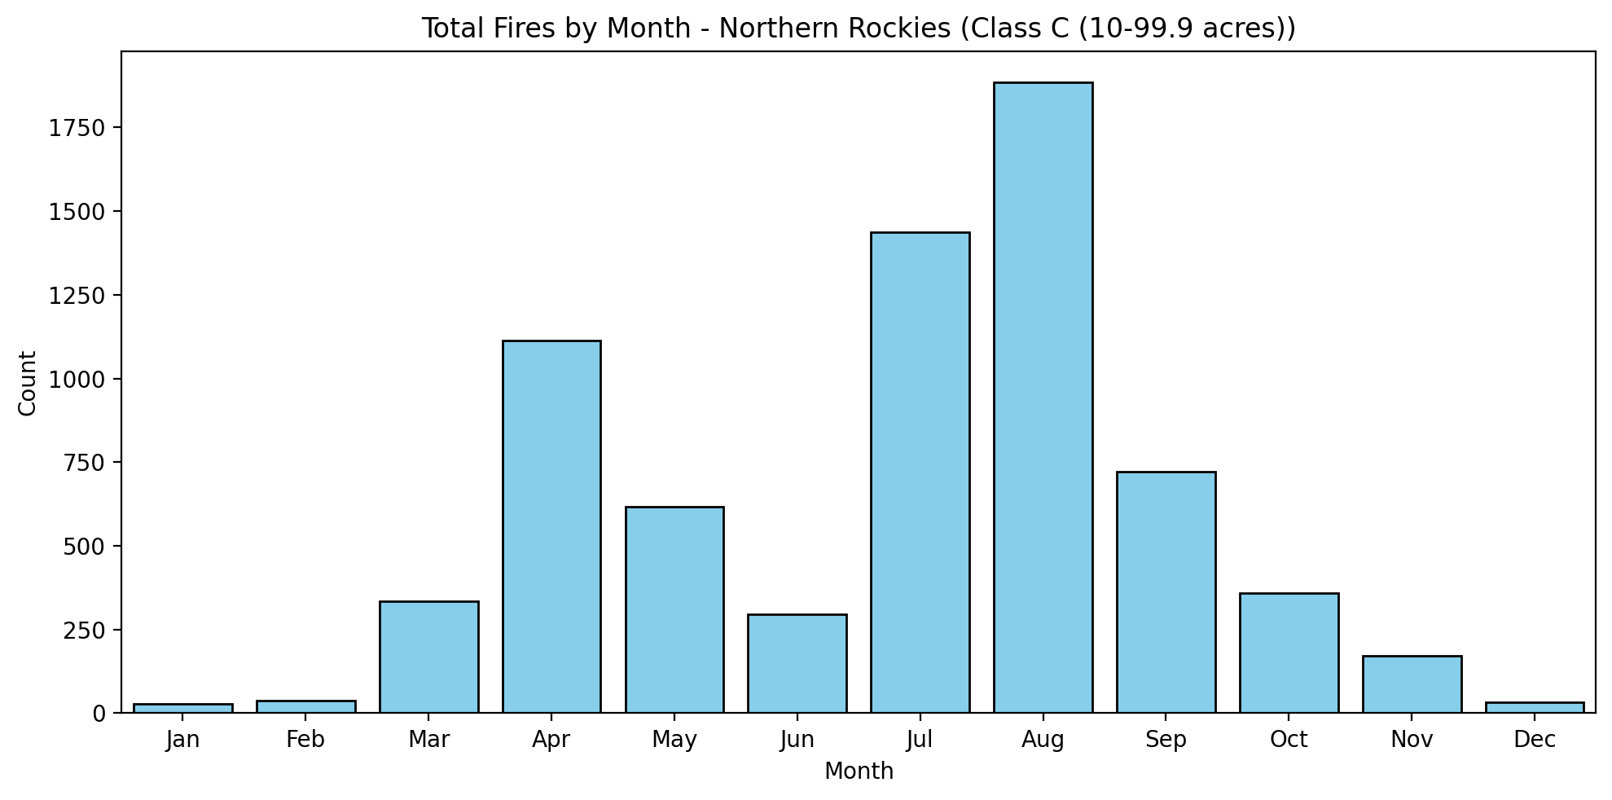
Northern Rockies: Class C (10-99.9 acres)

Slide 16

Northern Rockies: Class D (100-299 acres)
1,769 fires
Human: 914 fires
median 150.0 acres
Natural: 855 fires
median 158.0 acres
Rank-biserial r = -0.05
p = 0.055
No meaningful difference

Slide 17
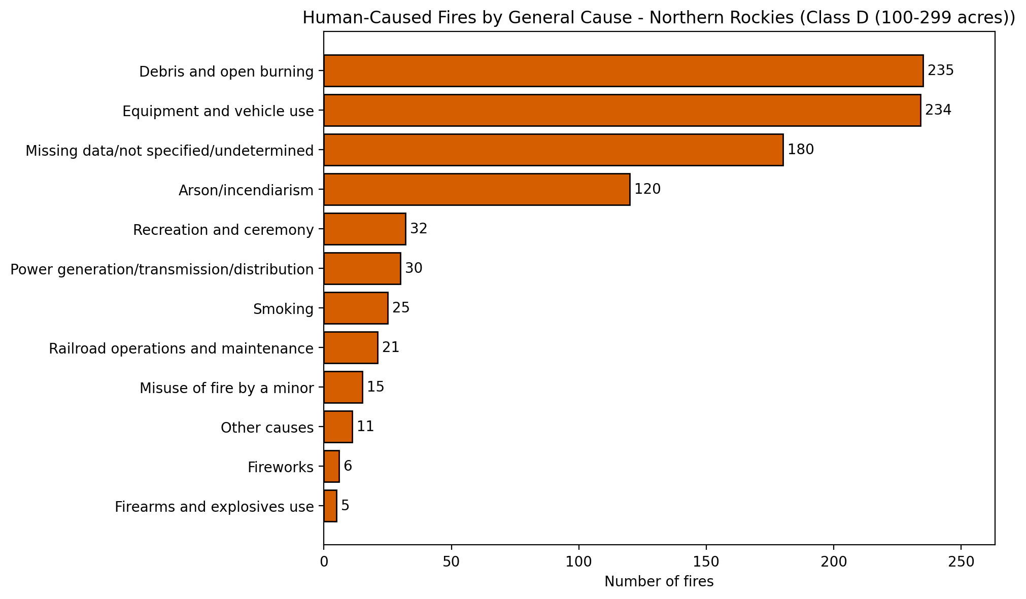
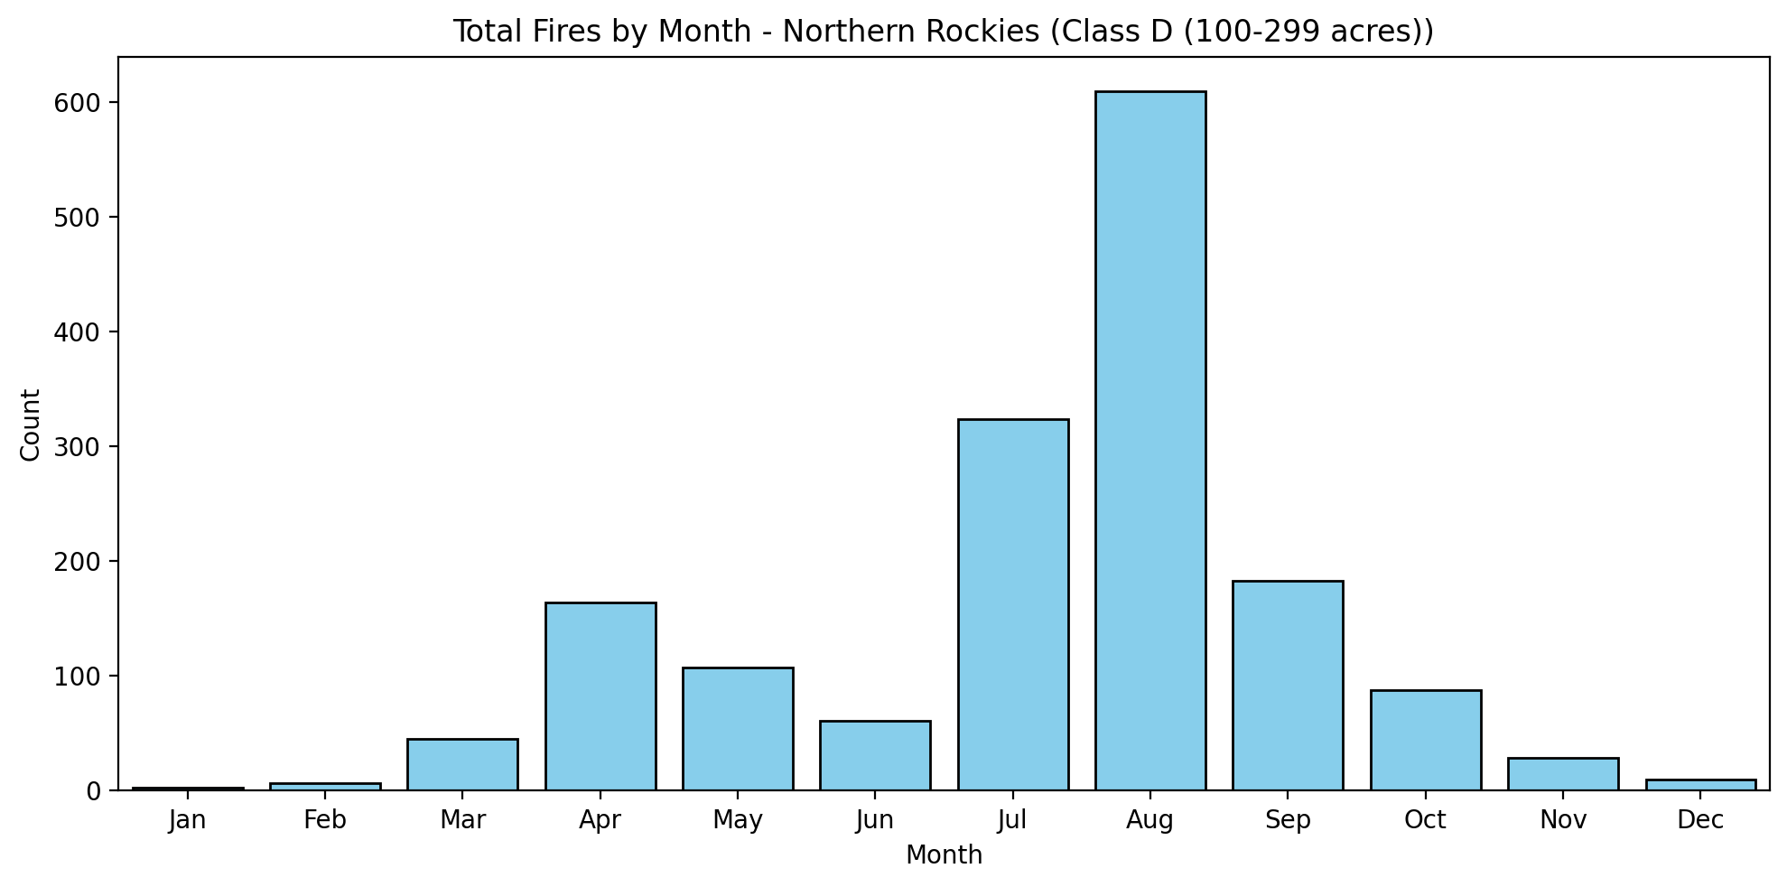
Northern Rockies: Class D (100-299 acres)

Slide 18

Northern Rockies: Class E (300-999 acres)
1,230 fires
Human: 512 fires
median 474.0 acres
Natural: 718 fires
median 528.5 acres
Rank-biserial r = -0.14
p = 2.4e-05
Natural Larger

Slide 19
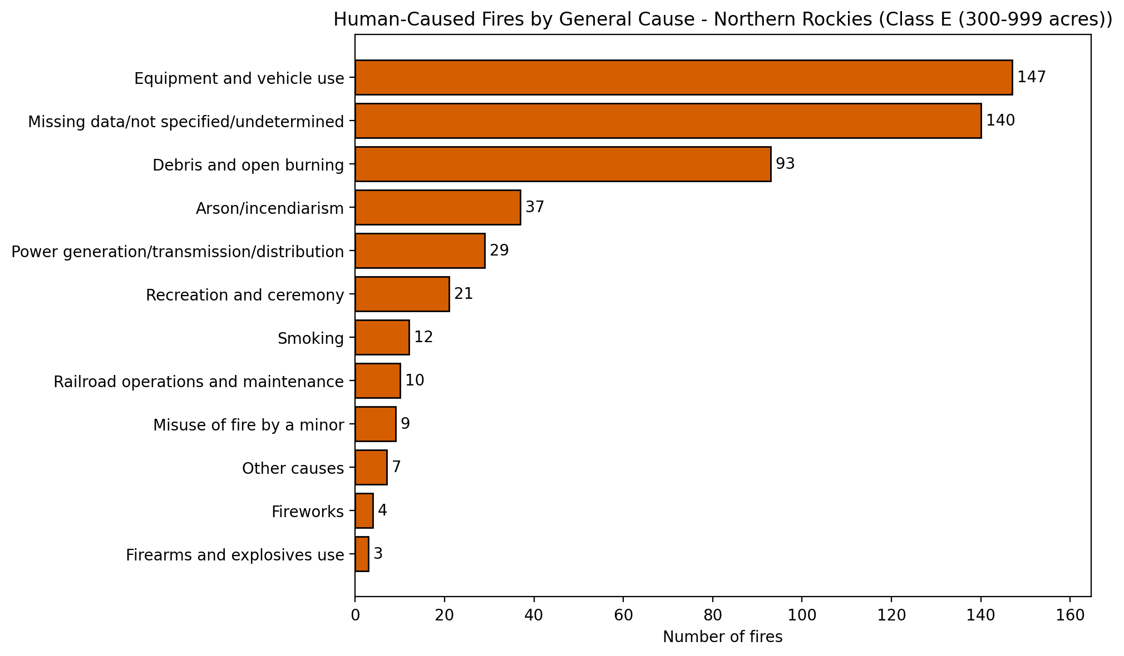
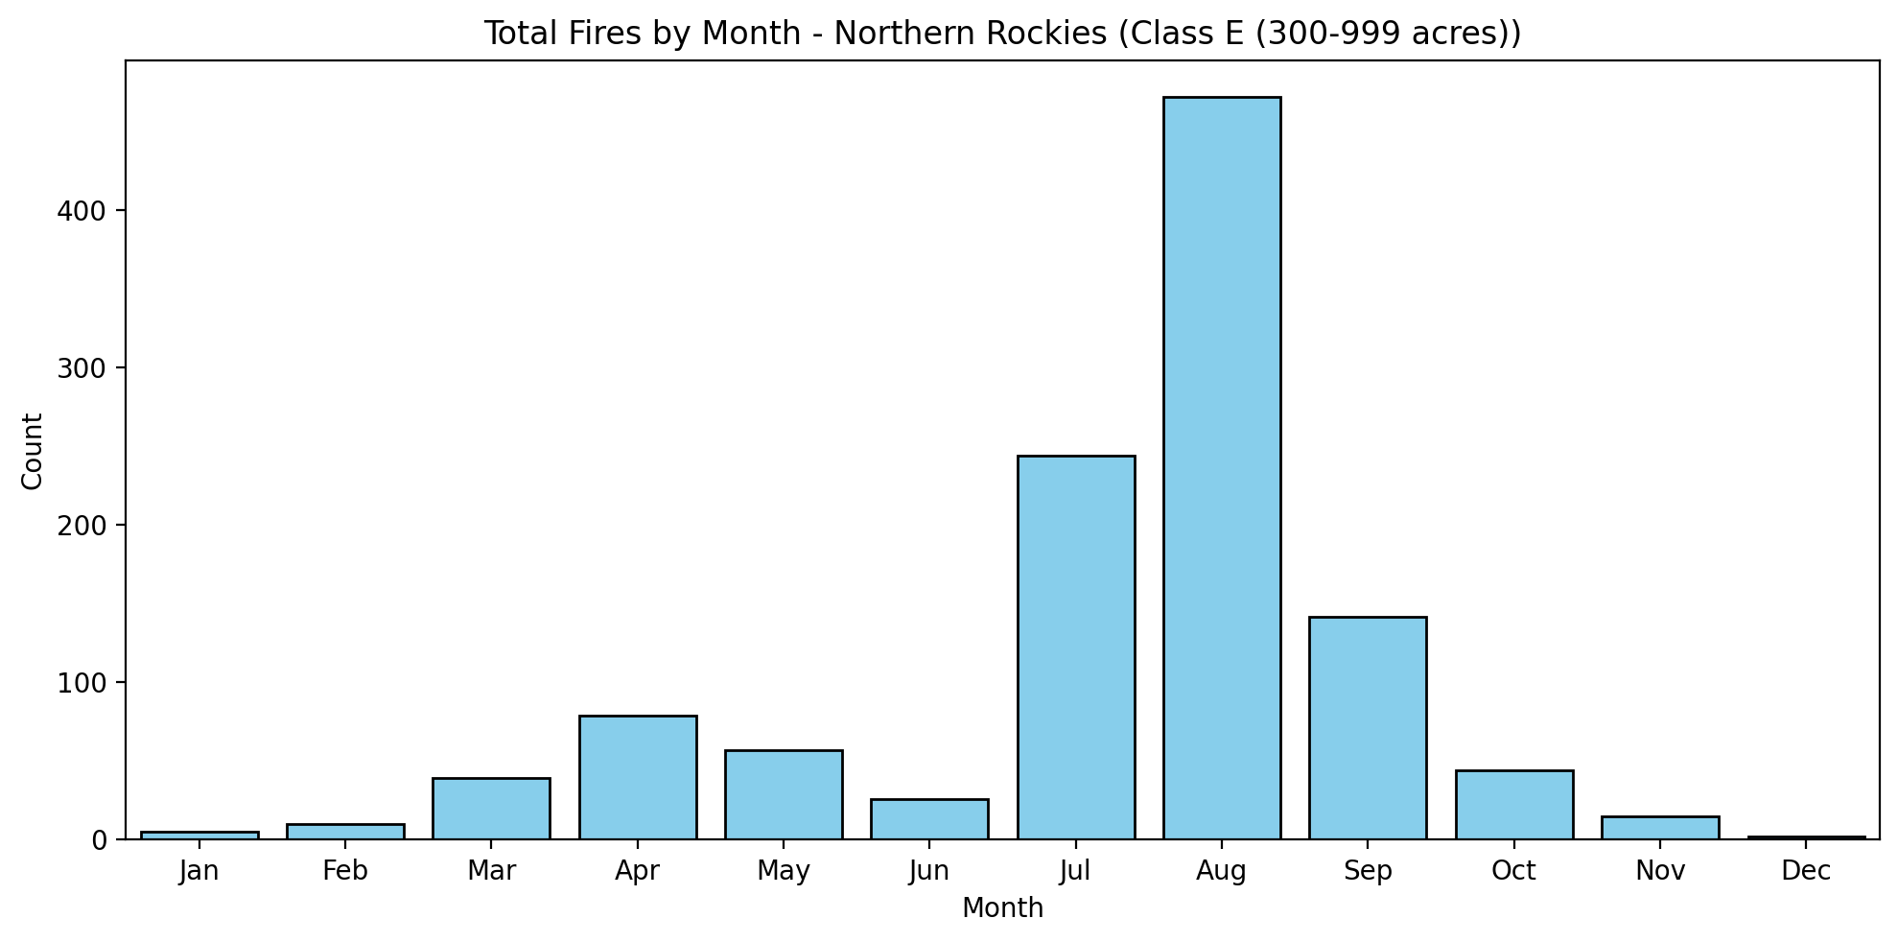
Northern Rockies: Class E (300-999 acres)

Slide 20

Northern Rockies: Class F (1,000-4,999 acres)
893 fires
Human: 275 fires
median 1,684.0 acres
Natural: 618 fires
median 1,980.8 acres
Rank-biserial r = -0.12
p = 0.004
Natural Larger

Slide 21
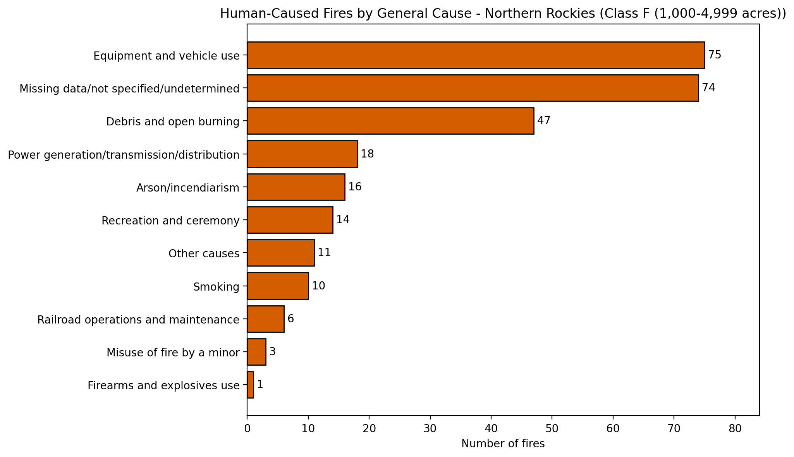
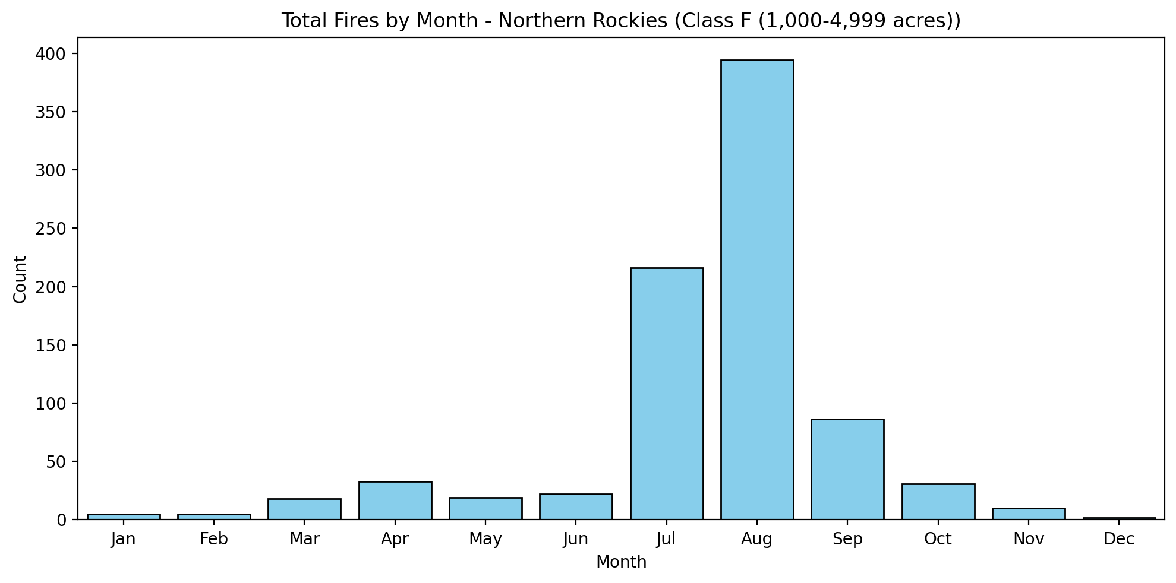
Northern Rockies: Class F (1,000-4,999 acres)

Slide 22

Northern Rockies: Class G (5,000+ acres)
456 fires
Human: 90 fires
median 8,941.0 acres
Natural: 366 fires
median 11,162.5 acres
Rank-biserial r = -0.19
p = 0.0052
No meaningful difference

Slide 23
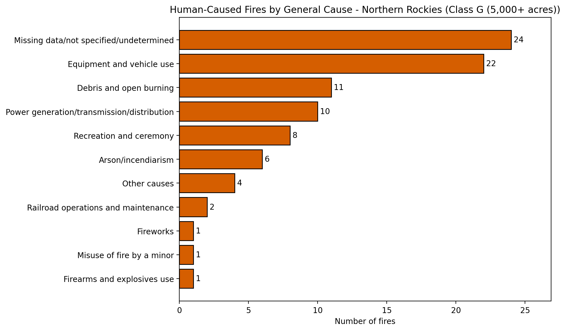
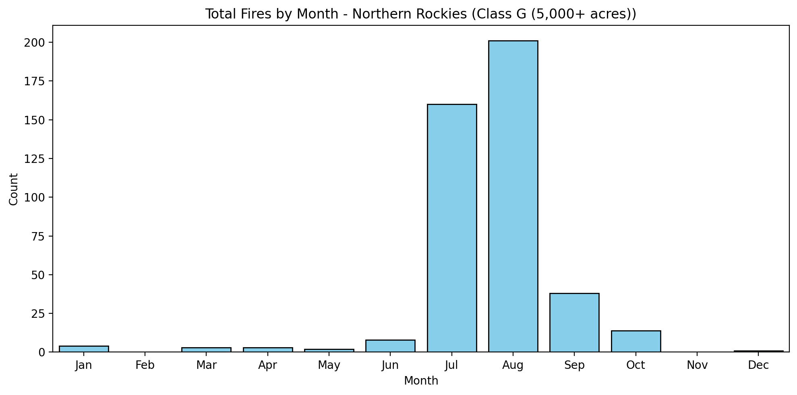
Northern Rockies: Class G (5,000+ acres)

